Slide 1
Tank shooter
Md Mizanur Rahman
Ruhan Yashik
Faruk Hossain

Slide 2
Motivation
Exciting
Game industry
I love tanks

Slide 3
Features
Hero tanks
Enemy tanks
Maps
Objective
Mission
Leaderboard

Slide 4
Features
Hero tanks
Enemy tanks
Maps
Objective
Mission
Leaderboard

Slide 5
Tentative Schedule

Slide 6
Estimated project proposal presentation
Responsibility chaining of project
Final project presentation
08.22.17
09.08.17
09.15.17
10.02.17
11.01.XX
Updated Uml and use case diagram submission
Mid project presentation

Slide 7
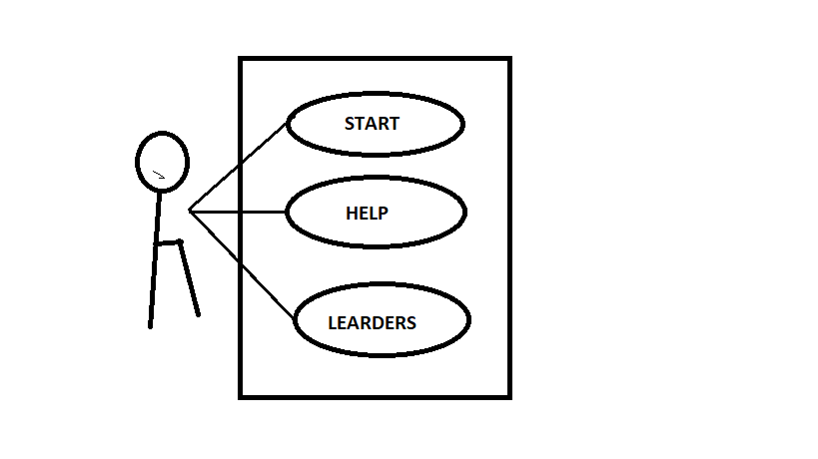
Tentative Use case Diagram

Slide 8
Class Diagram

Slide 9
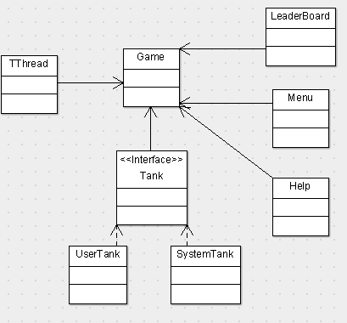

Slide 10
Design patterns
Strategy
Observer
Singleton
Factory

Slide 11
UI and UX

Slide 12
UI and UX

Slide 13
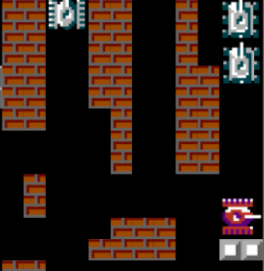
UI and UX

Slide 14
UI and UX

Slide 15
Thank YOu

